Slide 1
Java API for XML Processing
(JAXP)
توسط: محمّدمهدي حامد
استاد راهنما: دكتر مسعود رهگذر

Slide 2
XML
Extensible Markup Language
W3C Standard
XML Documents
  Well-Formed
    Element must have an open tag and a close tag
    One root element that contains all other elements
  Valid
    DTD
    XML Schema

Slide 3
XML and Java
Java: Portable Language
XML: Portable Data

Slide 4
XML and Java
Java API for XML-Based Web Services (JAX-WS)
Java API for XML Processing (JAXP)
Java Architecture for XML Binding (JAXB)
Java API for XML Messaging (JAXM)
Java API for XML Registries (JAXR)
Java API for XML-Based RPC (JAX-RPC)
Java 2 Platform, Enterprise Edition (J2EE)

Slide 5
JAXP
Java API for XML Processing
Includes
  SAX
  DOM
  XPath
  XSLT
  …

Slide 6
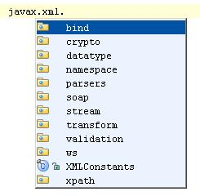
JAXP
javax.xml Package
  javax.xml.parsers
  javax.xml.validation
  javax.xml.transform
  javax.xml.xpath
  …

Slide 7
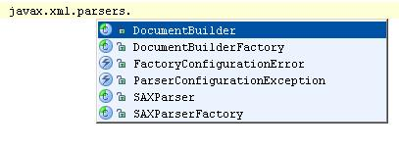
XML Parsers
javax.xml.parsers Package
SAX
  Stream Model
DOM
  Data Model

Slide 8
SAX
Simple API for XML
An Standard Interface
Different Implementations
  Xerces2 (Apache distribution)
  Ælfred parser
  Apache Crimson parser (in JDK 1.4)
  Oracle XML Parser
  Piccolo XML Parser
  …

Slide 9
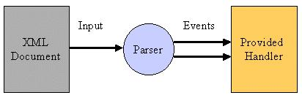
SAX
Stream Model
Lightweight and fast
Event-based API
  ContentHandler
  DTDHandler
  ErrorHandler
  EntityResolver
  …

Slide 10
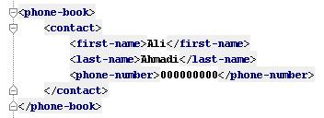
SAX Example
Events:
  startDocument
  startElement
  startElement
  startElement
  characters
  endElement
  …

Slide 11
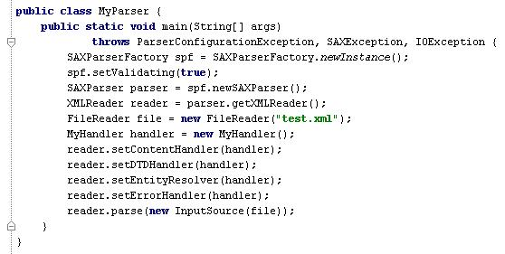
SAX in Java

Slide 12
SAX
Advantages
  Lightweight
  Fast
Problems
  No Random Access
  Can’t Change the Document
  Hard to Program
  Hard to Navigate the Document

Slide 13
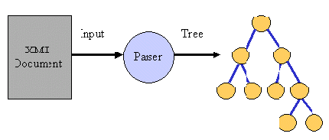
DOM
Document Object Model
An Standard Interface
Data Model
Tree Representation
  Two Kinds of Nodes
    Element
    Text

Slide 14
DOM Tree Traversing
Document Class
  Tree Runtime Representation
  Methods for Navigation
    getFirstChild()
    getNextSibling()
    getParentNode()
    …
  Methods for Changing the Document

Slide 15
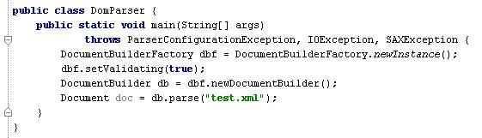
DOM in Java

Slide 16
DOM
Usually Implements on SAX
  SAX is Faster
In-Memory Representation
Tree Representation
  Easy to Traverse
  Traverse Forward and Backward
Easy to Program

Slide 17
Thanks
?

